Slide 1
Experience of bunch compression with linearising achromats in the MAX IV Linac
Sara Thorin, MAX IV Laboratory

Slide 2
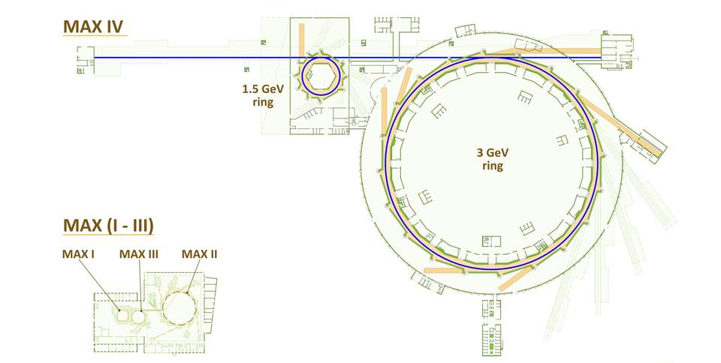
MAX IV
SPF
Linac
1.5 GeV ring – circumference 96 m
3 GeV ring – circumference 528 m
Linac 250 m long
13 beamlines funded
26 beamlines in 2026
Short Pulse Facility
Notes:
Funded 2009
Inauguration summer 2016

Slide 3
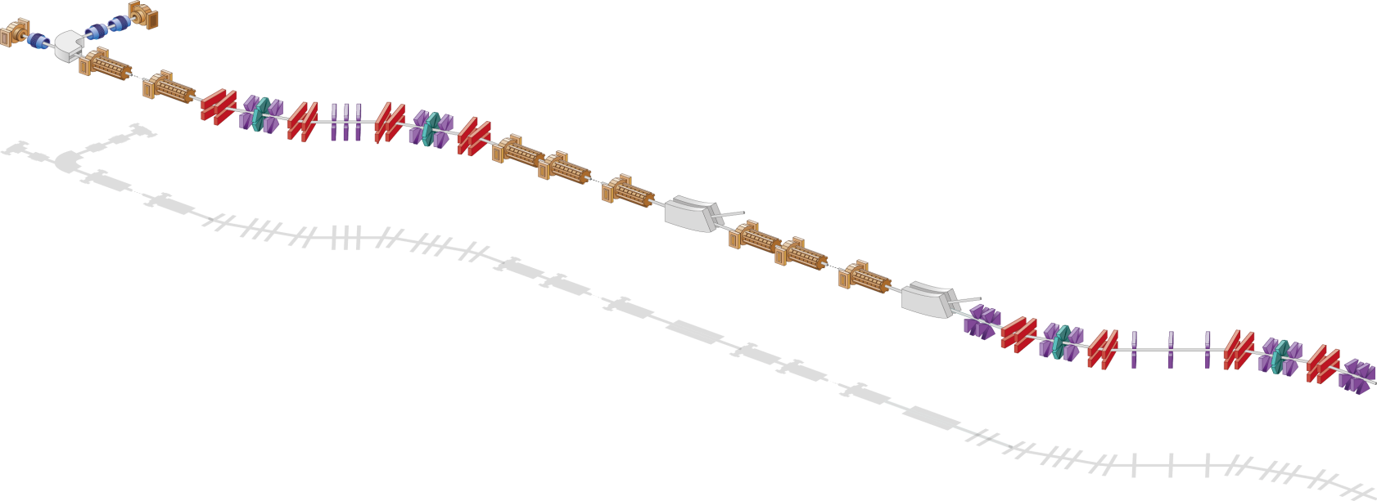
MAX IV linac overview
Thermionic RF gun
Photo cathode RF gun
Extraction
1.5 GeV
BC1 @ 260 MeV
Extraction
3 GeV
Full energy injection and top up operation for the two storage rings
BC2 @ 3 GeV
SPF
 | Design | Currently
Energy | 1.5 GeV/ 3GeV | 1.5 GeV/ 3GeV
Repetition rate | 10 Hz | 2 Hz
Charge | 0.6-1 nC/shot | 0.3 nC/shot
Emittance | 10 mm mrad | 5 mm mrad
Energy spread | <0.2% | ^{<0.25 %}

Slide 4
MAX IV linac overview
Thermionic RF gun
Photo cathode RF gun
Extraction
1.5 GeV
BC1 @ 260 MeV
Extraction
3 GeV
Full energy injection and top up operation for the two storage rings
BC2 @ 3 GeV
SPF
High brightness driver for the Short Pulse Facility
 | Design | Currently
Energy | 1.5 GeV/ 3GeV | 1.5 GeV/ 3GeV
Repetition rate | 10 Hz | 2 Hz
Charge | 0.6-1 nC/shot | 0.3 nC/shot
Emittance | 10 mm mrad | 5 mm mrad
Energy spread | <0.2% | ^{<0.25 %}
 | Design | Currently
Energy | 3GeV | 3 GeV
Repetition rate | 100 Hz | 2 Hz
Charge | 100 pC | 100-300 pC
Bunch length (rms) | 100 fs | 3 ps – 300 fs
Emittance | 1 mm mrad | 1-3 mm mrad
Energy spread | <0.4% | ^{0.05-0.5%}

Slide 5
MAX IV linac overview
Thermionic RF gun
Photo cathode RF gun
Extraction
1.5 GeV
BC1 @ 260 MeV
Extraction
3 GeV
Full energy injection and top up operation for the two storage rings
BC2 @ 3 GeV
SPF
High brightness driver for the Short Pulse Facility
 | Design | Currently
Energy | 1.5 GeV/ 3GeV | 1.5 GeV/ 3GeV
Repetition rate | 10 Hz | 2 Hz
Charge | 0.6-1 nC/shot | 0.3 nC/shot
Emittance | 10 mm mrad | 5 mm mrad
Energy spread | <0.2% | ^{<0.25 %}
 | Design | Currently
Energy | 3GeV | 3 GeV
Repetition rate | 100 Hz | 2 Hz
Charge | 100 pC | 100-300 pC
Bunch length (rms) | 100 fs | 3 ps – 300 fs
Emittance | 1 mm mrad | 1-3 mm mrad
Energy spread | <0.4% | ^{0.05-0.5%}
Possible future Free Electron Laser

Slide 6
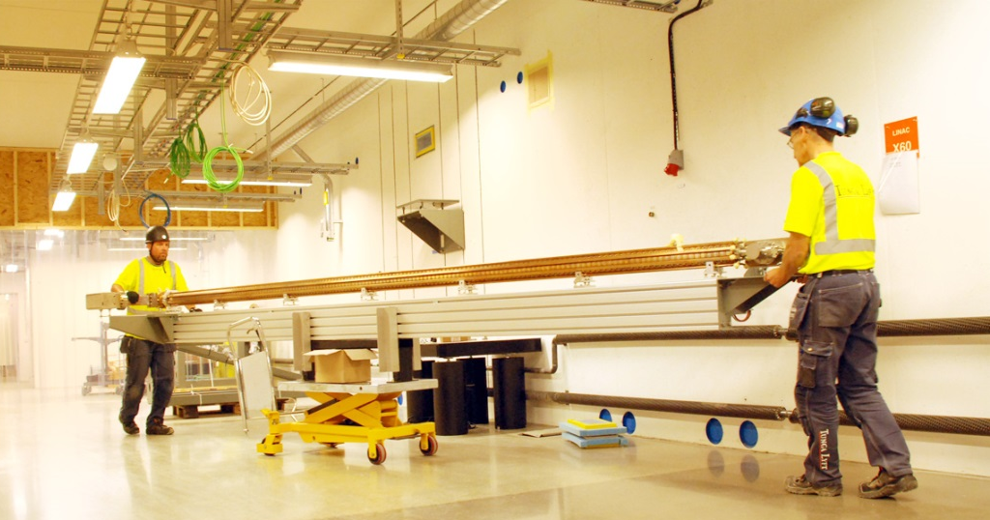
MAX IV linac timeline
 | 2010 | 2011 | 2012 | 2013 | 2014 | 2015 | 2016 | 2017
Linac building
Linac installation
Linac commissioning
Linac operation

Slide 7
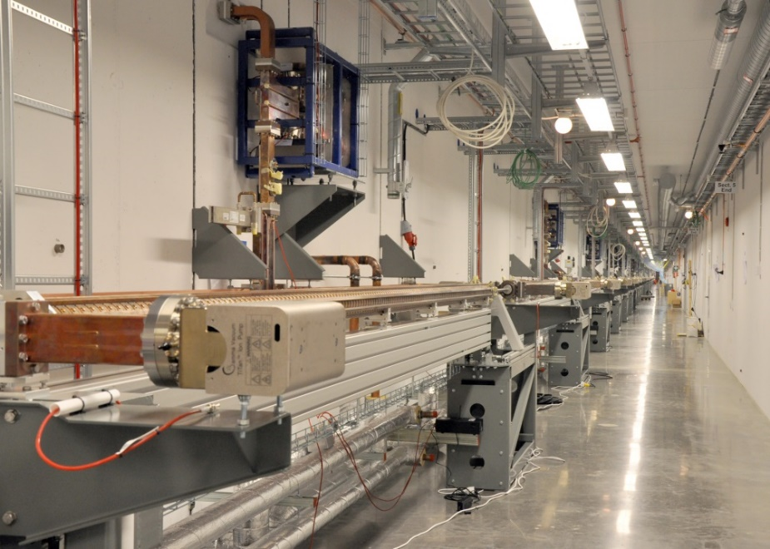
MAX IV linac timeline
 | 2010 | 2011 | 2012 | 2013 | 2014 | 2015 | 2016 | 2017
Linac building
Linac installation
Linac commissioning
Linac operation

Slide 8
MAX IV linac timeline
 | 2010 | 2011 | 2012 | 2013 | 2014 | 2015 | 2016 | 2017
Linac building
Linac installation
Linac commissioning
Linac operation
Inauguration
The MAX IV linac is now routinely delivering injection and top up to both storagerings, and short pulses to the SPF.

Slide 9
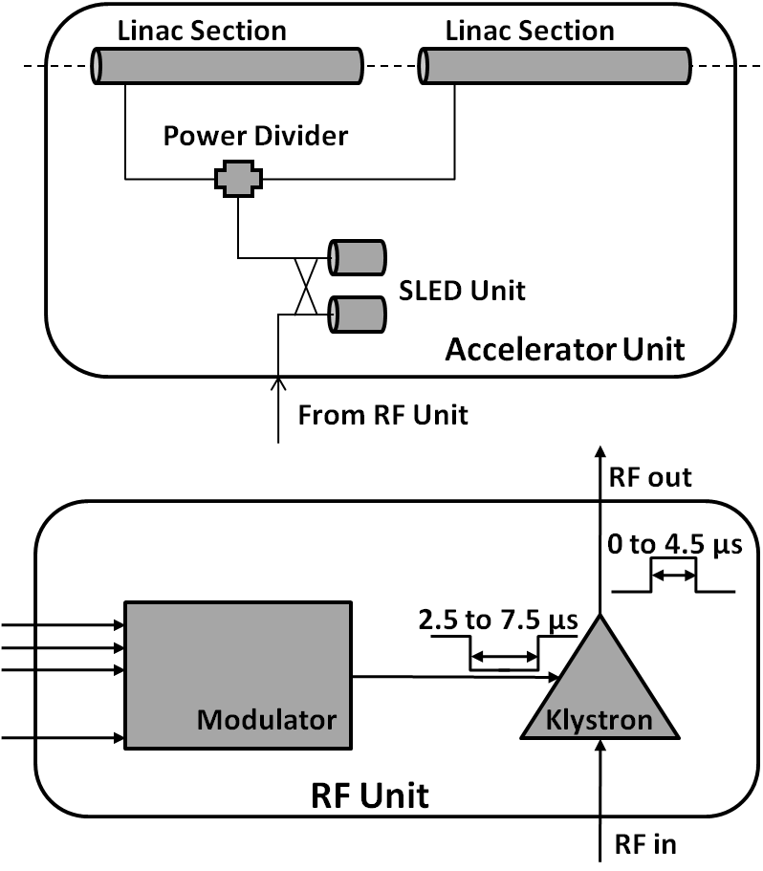
MAX IV linac
Extraction
3 GeV
Thermionic RF gun
L9B
Kicker & septum
L19B
L0
L1B
Photo cathode RF gun
39 warm s-band linac structures + SLED
20 units
3 GHz
5.3 m/linac
20 MV/m gradient
3 + 0.4 GeV
20 modulators + klystrons
37 MW peak power
4.5 ms
100 Hz
Thermionic gun: 8 MW 10 Hz RF unit
Notes:
Sits in two different tunnels

Slide 10
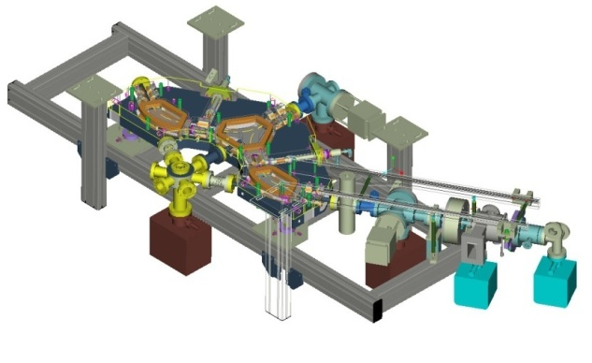
MAX IV linac
Extraction
3 GeV
Thermionic RF gun
L9B
Kicker & septum
L19B
L0
L1B
Photo cathode RF gun
39 warm s-band linac structures + SLED
20 units
3 GHz
5.3 m/linac
20 MV/m gradient
3 + 0.4 GeV
20 modulators + klystrons
37 MW peak power
4.5 ms
100 Hz
Thermionic gun: 8 MW 10 Hz RF unit
Notes:
Sits in two different tunnels

Slide 11
MAX IV linac
Extraction
3 GeV
Thermionic RF gun
L9B
Kicker & septum
L19B
L0
L1B
Photo cathode RF gun
39 warm s-band linac structures + SLED
20 units
3 GHz
5.3 m/linac
20 MV/m gradient
3 + 0.4 GeV
20 modulators + klystrons
37 MW peak power
4.5 ms
100 Hz
Thermionic gun: 8 MW 10 Hz RF unit
Notes:
Sits in two different tunnels

Slide 12
MAX IV linac
Wanted: Short pulses for SPF and possible future FEL
Had: No money for it
Extraction
3 GeV
Thermionic RF gun
L9B
Kicker & septum
L19B
L0
L1B
Photo cathode RF gun
39 warm s-band linac structures + SLED
20 units
3 GHz
5.3 m/linac
20 MV/m gradient
3 + 0.4 GeV
20 modulators + klystrons
37 MW peak power
4.5 ms
100 Hz
Thermionic gun: 8 MW 10 Hz RF unit
Notes:
Sits in two different tunnels

Slide 13
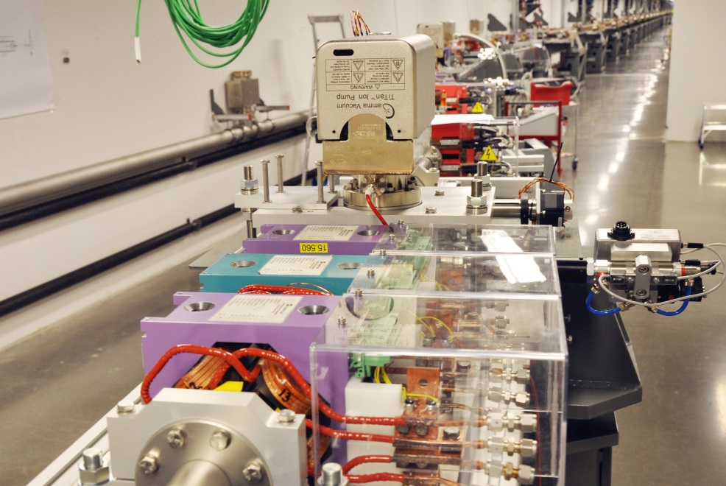
Bunch compressors – self-linearising double achromats
4
BC1
quad
R56 > 0
T566 > 0
0
dipole
2
sext
E
E
Y[m]
-2
E_{mean}
2
4
6
X[m]
8
10
12
z
z
 | BC1 | BC2
R56 | 2.23 cm | 2.6 cm
T566 | 8.05 cm | 4.26 cm

Slide 14
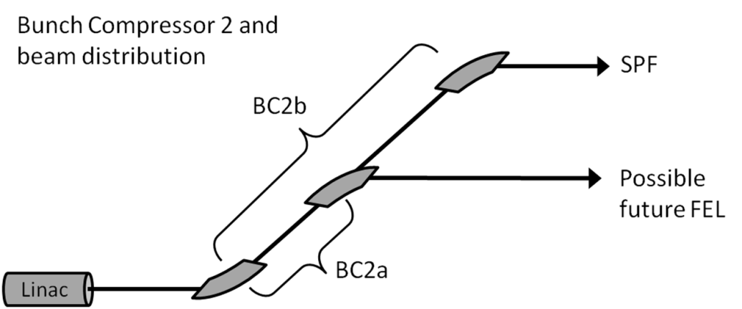
Bunch compressors
Why self linearising compression?
economy
reliability
simplicity
Why compression in double achromats?
positive R56 (fixed)
positive T566 for linearisation
“weak” sextupoles for tuning
symmetry → small energy depending matrix elements
beam spreader
4
BC1
quad
0
dipole
2
sext
Y[m]
-2
2
4
6
8
10
12
X[m]
Longitudinal wakefield influence
The wakes will enhance the chirp
The more we compress in BC1, the stronger the chirp gets in the main linac
Residual chirp at the end of the linac

Slide 15
Simulation results - SPF-pulse
Gun – 1st linac: ASTRA
Linac + compressors: ELEGANT
Charge | 100 pC
Δt fwhm | 100 fs
Peak current | 1.5 kA
Compression factor | 50
Slice εN | 0.42 mm mrad
Proj εN | 0.55 mm mrad
Emittance increase | 5 %
Slice ΔE/E | 0.035 %

Slide 16
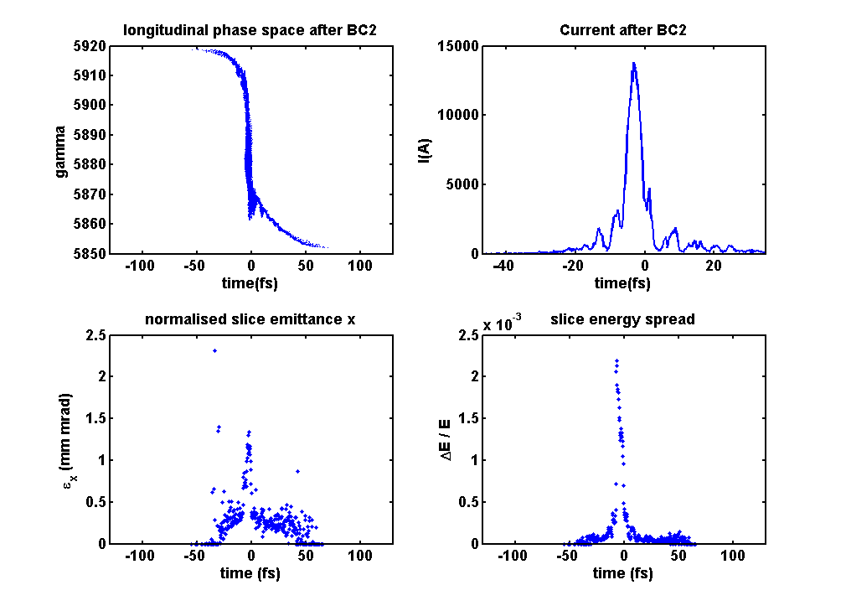
Simulation results - full compression
Gun – 1st linac: ASTRA
Linac + compressors: ELEGANT
Charge | 100 pC
Δt fwhm | 10 fs
Peak current | 14 kA
Compression factor | 500
Slice εN | 1.5 mm mrad
Proj εN | 2.4 mm mrad
Emittance increase (slice) | 375 %
Slice ΔE/E | 0.25 %

Slide 17
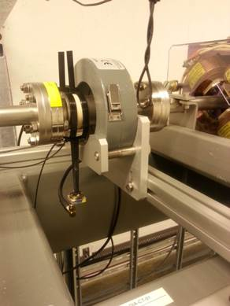
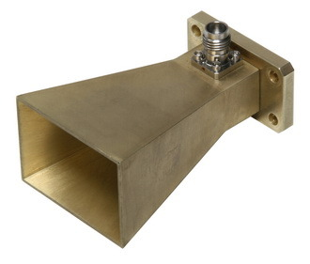
Relative bunch length measurements with horn antennas
Extraction
3 GeV
Thermionic RF gun
L9B
Kicker & septum
L19B
L0
L1B
Photo cathode RF gun
~170 GHz
~250 GHz
D. Olsson reproduced a benchmark model of FERMI gap
+ photodiode

Slide 18
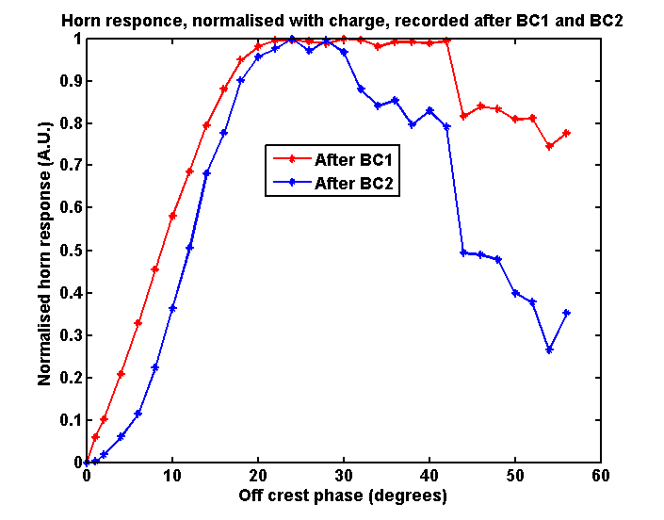
Relative bunch length measurements with horn antennas
Extraction
3 GeV
Thermionic RF gun
L9B
Kicker & septum
L19B
L0
L1B
Photo cathode RF gun
Effects of wakefield enhancement of chirp
~ 300 fs @ plateau after BC1
~ 200 fs @ plateau after BC2

Slide 19
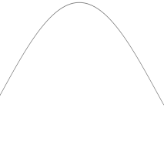
Longitudinal profile measurement with variant of the zero-crossing method
Extraction
3 GeV
Thermionic RF gun
L9B
Kicker & septum
L19B
L0
L1B
Photo cathode RF gun
Beam compressed in BC1
Measurement parameters
Compression energy | 265 MeV
Final Energy | 2.98 GeV
Compression phase | Scanned 0-50 degrees off crest
Initial electron bunch length rms | 3 ps
Charge | 100 pC
Dispersion at the screen | 0.32 m
Sextupole value | K₂ = 35 m⁻³
Screen at maximum dispersion
BC2
20º off crest
Main linac
Dispersion
Off crest phase
Δx → Δt

Slide 20
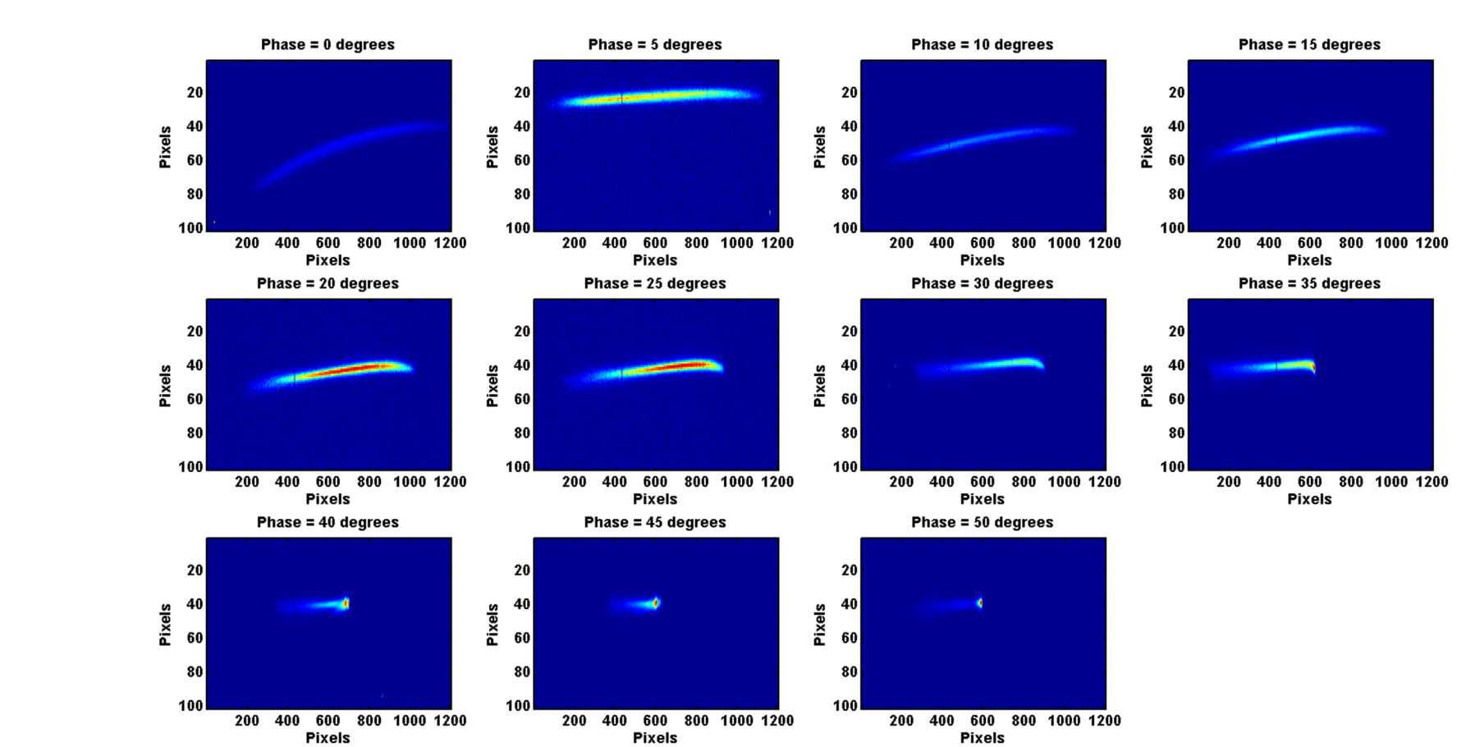
Longitudinal profile measurement with variant of the zero-crossing method
Extraction
3 GeV
Thermionic RF gun
L9B
Kicker & septum
L19B
L0
L1B
Photo cathode RF gun

Slide 21
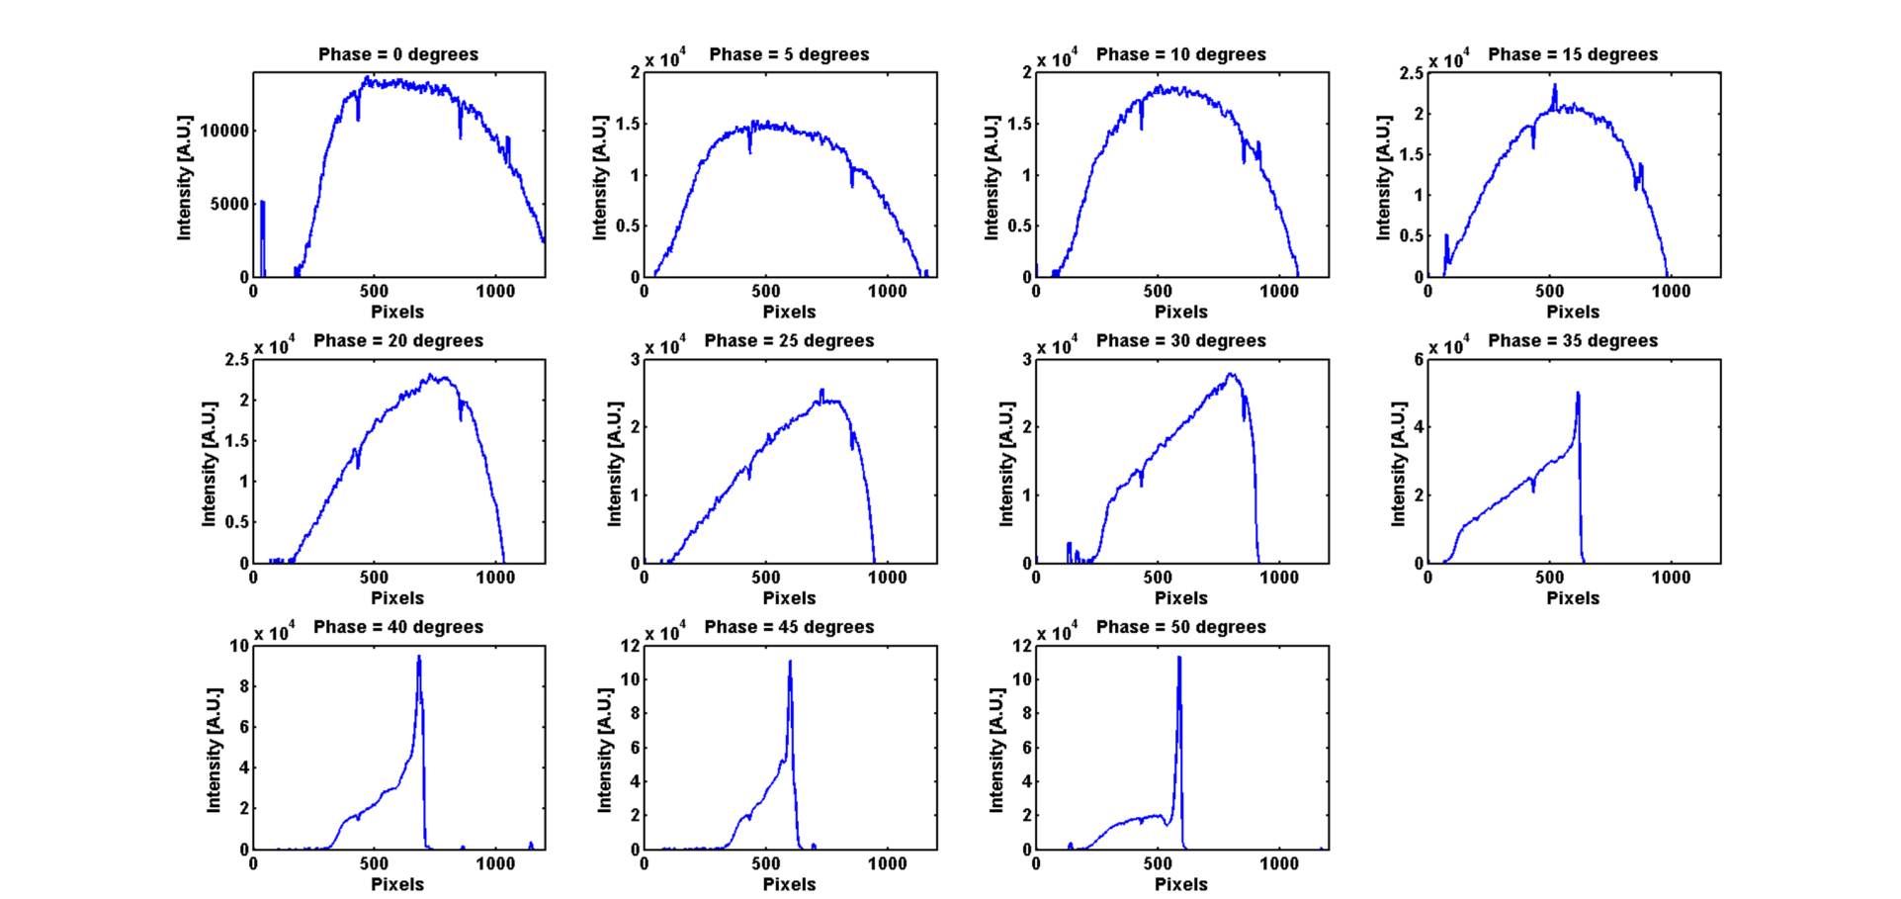
Longitudinal profile measurement with variant of the zero-crossing method
Extraction
3 GeV
Thermionic RF gun
L9B
Kicker & septum
L19B
L0
L1B
Photo cathode RF gun

Slide 22
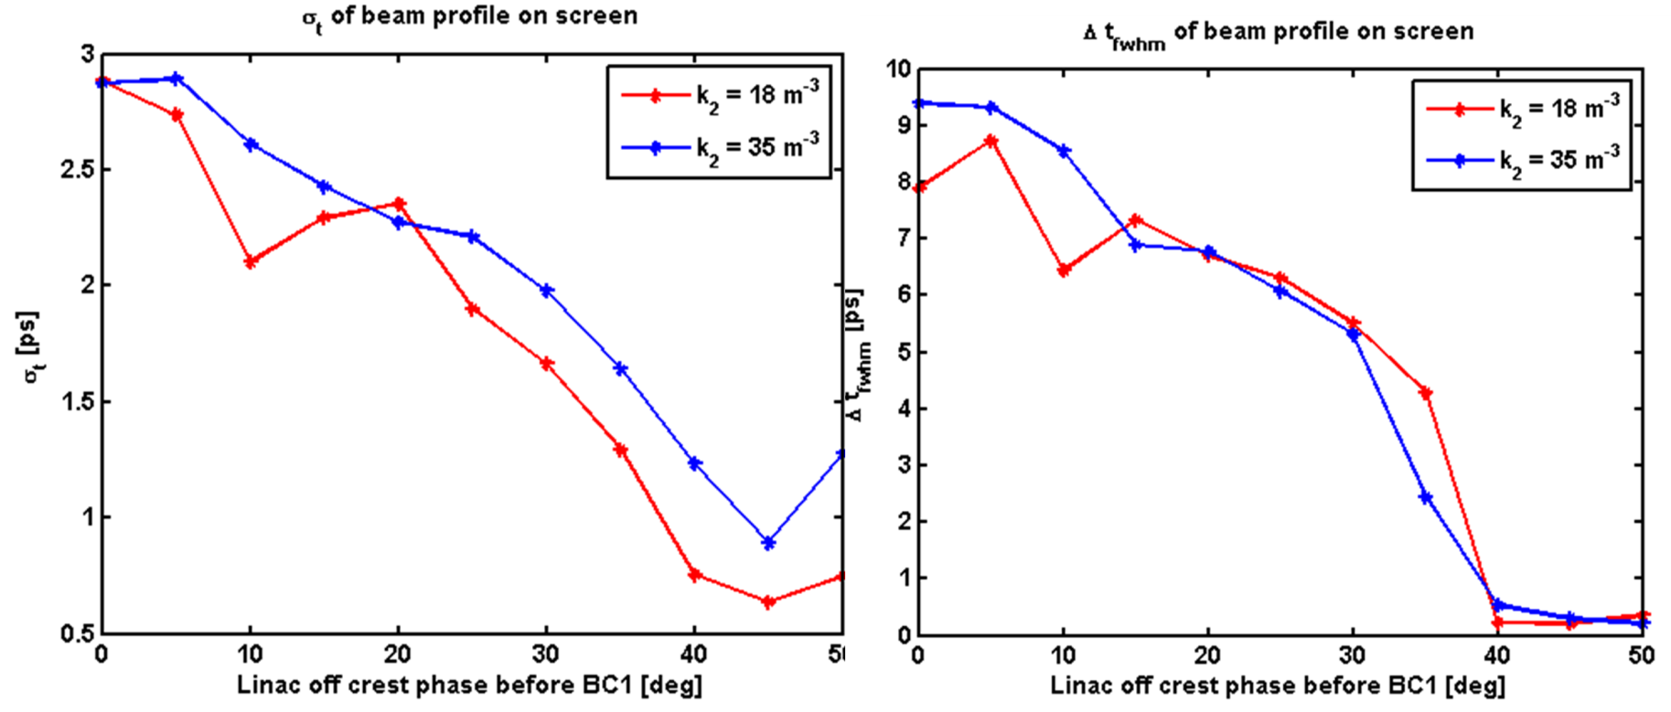
Longitudinal profile measurement with variant of the zero-crossing method
Extraction
3 GeV
Thermionic RF gun
L9B
Kicker & septum
L19B
L0
L1B
Photo cathode RF gun

Slide 23
Bunch compression – sextupole dependence
Intensity [A.U.]]
Pixels

Slide 24
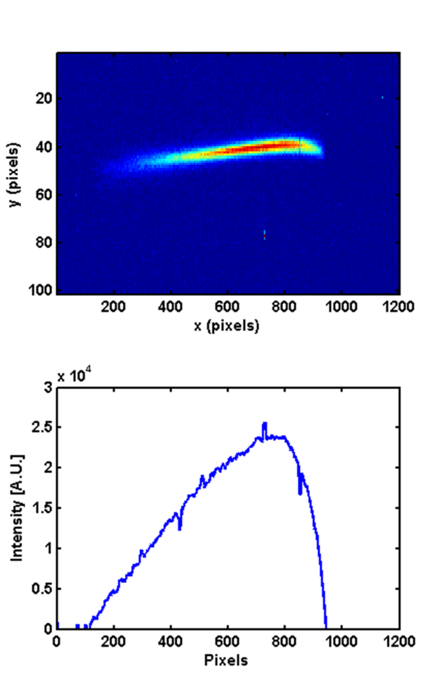
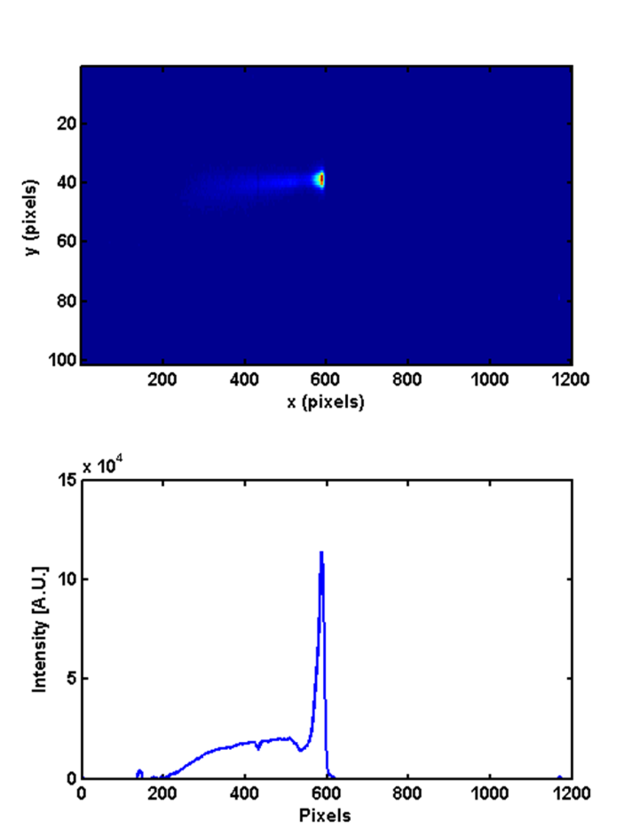
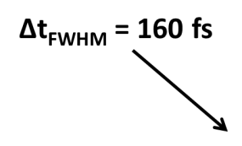

Longitudinal profile measurement with variant of the zero-crossing method
Extraction
3 GeV
Thermionic RF gun
L9B
Kicker & septum
L19B
L0
L1B
Photo cathode RF gun

Slide 25
Longitudinal profile measurement with variant of the zero-crossing method
Extraction
3 GeV
Thermionic RF gun
L9B
Kicker & septum
L19B
L0
L1B
Photo cathode RF gun
Not fully linearised at high compression after BC1

Slide 26
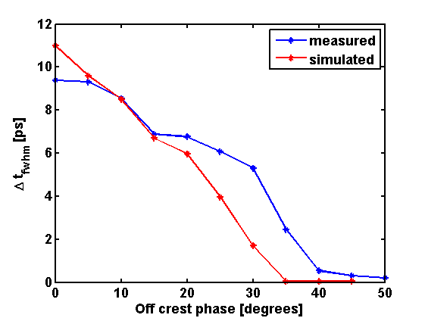
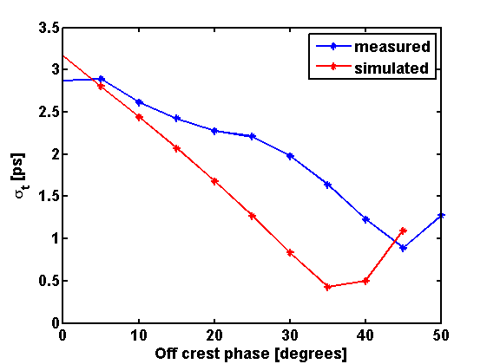
Comparing off crest measurements with simulations
FWHM
Sigma values

Slide 27
Comparing off crest measurements with simulations
FWHM
Sigma values

Slide 28
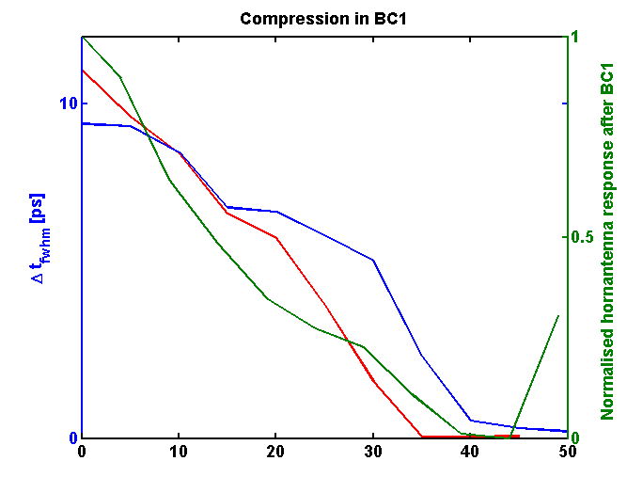
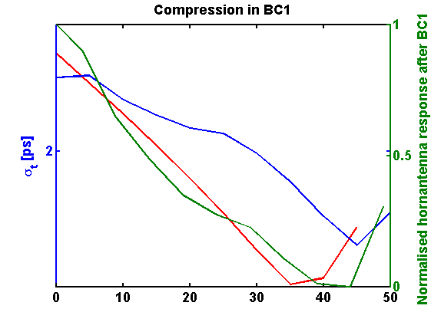
Comparing off crest measurements with horn antennas and simulations
FWHM
Sigma values
Horn antenna
Horn antenna
Off crest measurement
Off crest measurement
Elegant
Elegant

Slide 29
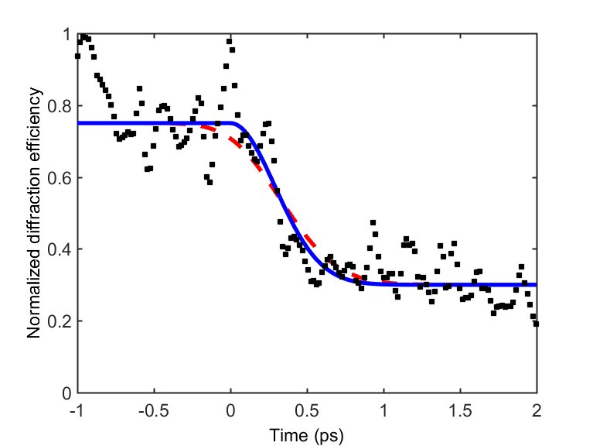
Non-thermal melting of InSb in crossed-beam geometry at FemtoMAX
Short pulse+
Lindenberg model
400 fs pulse+
Lindenberg model
Repetition of SPPS experiment to estimate pulse duration. Non-thermal melting in InSb.
A. Lindenberg, J. Larsson, K. Sokolowski-Tinten. K. Gaffney & SPPS Collab., Science 308, 392 (2005).

Slide 30
Summary and outlook
Extraction
3 GeV
Thermionic RF gun
L9B
Kicker & septum
L19B
L0
L1B
Photo cathode RF gun
Horn antenna measurements indicate a bunch length below 300 fs after BC1 and below 200 fs after BC2
Measurements of longitudinal phase space in BC2 shows a current spike at 160 fs, after compression in BC1
Measurements of longitudinal phase space could be done after the beam dump magnet.
Design and construction of a transverse deflecting cavity is in progress

Slide 31
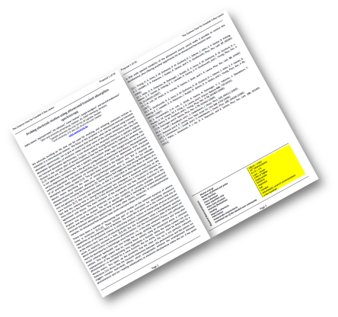
Outlook and summary
Extraction
3 GeV
Thermionic RF gun
L9B
Kicker & septum
L19B
L0
L1B
Photo cathode RF gun
BC2 @ 3 GeV
U
FemtoMAX (SPF)
U
U
U
Soft X-ray FEL (SXL)
The science case for Swedish X-ray Lasers
Collaboration between MAX IV Laboratory, the Lund Laser Centre, the Stockholm-Uppsala FEL Centre, and Uppsala University
More than 40 proposals for science case
http://www.llc.lu.se/sxlf
Design report for a Soft X-ray FEL will most likely be funded.

Slide 32
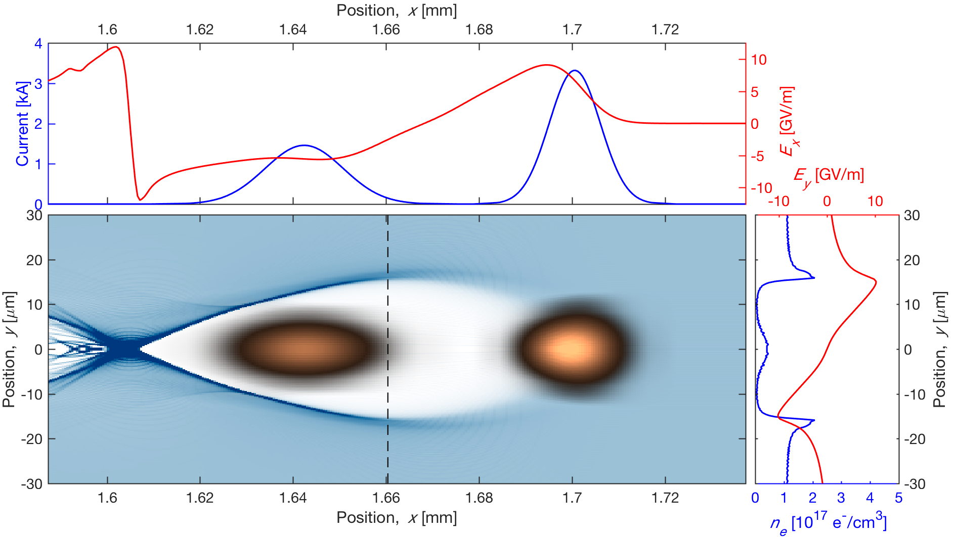
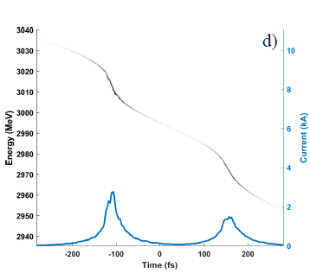
Outlook and summary
Extraction
3 GeV
Thermionic RF gun
L9B
Kicker & septum
L19B
L0
L1B
Photo cathode RF gun
Wakefield acceleration
BC2 @ 3 GeV
U
FemtoMAX (SPF)
U
U
U
Soft X-ray FEL (SXL)
Design report for a Soft X-ray FEL will most likely be funded.
We have started looking at the possibility for a wakefield acceleration experiment, O. Lund, Lund Laser Center

Slide 33
